Slide 1
Subscription Management Integration
Help customer manager there expenses at bay.

Slide 2
Intro Section
01 Intro
02 Our Team
03 Project Slide

Slide 3
Our Team
(Data Visionaries)
01 Vamsi Krishna Paladugu
02 Ram Prakash Reddy
03 Snehal Mankar
04 Ravi Singh

Slide 4
Problem Statement.
Multiple Subscriptions: Managing several subscriptions can be overwhelming, leading to missed payments and unwanted renewals.
Hidden Options: Current apps often tuck essential subscription management options within hidden menus, making accessibility difficult.
Complexity of Tracking: Tracking ongoing subscriptions and renewals manually requires significant time and effort.
Cancellation Challenges: Canceling services is frequently cumbersome and not straightforward, adding to user frustration.
Notification Inefficiencies: Users lack personalized notifications to help them stay on top of their payments and renewals.

Slide 5
Subscription Management Integration
Subscription Management: This credit card automatically tracks ongoing subscriptions, sends custom reminders for renewals, and allows users to cancel services directly from the card’s app.
Custom Subscription Events and Notifications: Customers can set up personalized subscription events and receive tailored notifications, ensuring they stay on top of their payments and renewals.

Slide 6
Features and Benefits
Automatic Subscription Tracking:
Automatically detects and lists all active subscriptions linked to the credit card.
Provides a consolidated view of all subscriptions, making it easier for users to manage them all in one place.
Custom Reminders for Renewals:
Sends personalized reminders before subscription renewals to help users avoid missed payments.
Users can set the frequency and timing of reminders based on their preferences.
Direct Cancellation from the App:
Allows users to cancel unwanted subscriptions directly from the app, streamlining the process and saving time.
Provides confirmation and updates the subscription list in real-time to reflect changes.
Personalized Subscription Events:
Enables users to create custom events related to their subscriptions, such as billing cycle changes or promotional offers.
Tailored notifications keep users informed about important events, helping them stay on top of their subscription management.

Slide 7
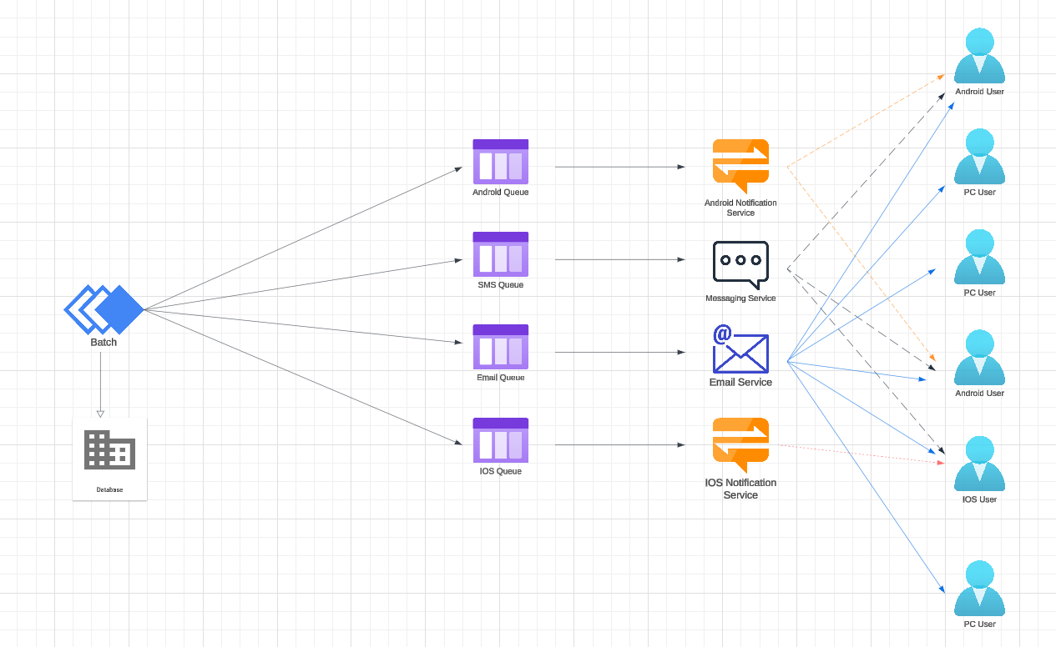
HIGH Level Architecture

Slide 8
Some Benefits of Subscription Management Integration.
For Businesses
Customer Retention: Regular engagement through subscriptions builds stronger relationships and improves customer loyalty, reducing churn.
Data Insights: Consistent interaction with subscribers provides rich data that can be used to understand customer preferences and improve offerings.
Cost Efficiency: Automation and streamlined processes associated with subscription management reduce operational costs.
Market Expansion: Subscriptions, especially digital, can easily reach a global audience, expanding market opportunities.
For Customers
Convenience: Automated, recurring deliveries or access to services eliminate the need for repeat purchases, saving time and effort.
Cost Savings: Often, subscriptions come with discounts or bundled offers, making them more economical over time.
Personalization: Subscription services can be tailored to customer preferences, offering a more personalized experience.
Exclusive Access: Subscribers often get early or exclusive access to new products, services, and special deals.
Stress-Free Management: Easy management of subscriptions, with options to pause, cancel, or upgrade, enhances the user experience.

Slide 9
THANK YOU

